Slide 1

1

Slide 2


NETWORK INTRUSION DETECTOR USING ML​
Second Year Project Synopsis
Submitted by
ROLL | NAME | ROLE
2301730315​ | Vaishvik Arora​ | Software
2301730299 | Ashwin Prakash | PPTs, Reports , Data Collection
Industry Mentor: Mr. Ashish Goguvan
Faculty Mentor: Dr. Digvijay
2
Notes:
New Courses replaced with New Programmes

Slide 3

Project Overview
Network Intrusion Detection Systems (NIDS) are designed to monitor network traffic for suspicious activity and alert the system or network administrator. Using machine learning, we can build models that automatically detect and potentially even prevent intrusions by analyzing patterns and anomalies in network data.​
​
Key Approaches:​
Supervised Learning: Trains on labeled data (e.g., decision trees, SVM).​
Unsupervised Learning: Identifies anomalies in unlabeled data (e.g., clustering, autoencoders).​
Reinforcement Learning: Learns from feedback to improve detection over time.​
​
Benefits:​
Adaptable to new threats​
Scalable for large datasets​
Reduced false positives and real-time detection​
3
Notes:
New Courses replaced with New Programmes

Slide 4
Specific Objectives​
Data & Resources​
Tools, Software, and Techniques Used:​
Programming: Python​
Libraries: Scikit-learn, Pandas, NumPy​,matplotlib.pyplot , joblib, seaborn
Datasets: KDD Cup 1999, NSL-KDD
Machine Learning Model: Random Forest ​Classifier
​
Training and Testing data for the model was gathered from a website called Github.
To develop an adaptive, scalable, and efficient network intrusion detection system using machine learning to enhance security and reduce response times.​
Implement machine learning algorithms to detect both known and unknown network threats.​
Minimize false positives to improve detection accuracy and reduce alert fatigue.​
Enable real-time intrusion detection for large-scale network environments.​
Continuously adapt the system to evolving attack patterns and new vulnerabilities.​
4

Slide 5
Key Features
Key Features of Network Intrusion Detection System:-​
Machine Learning Integration:​
Utilizes advanced machine learning algorithms (e.g., Decision Trees, Random Forest, SVM) for accurate intrusion detection.​
Real-time Monitoring:​
Continuously monitors network traffic for any signs of malicious activity, providing instant alerts.​
Comprehensive Data Analysis:​
Analyzes large datasets with high accuracy and minimal false positives.​
​
Scalability:​
Capable of scaling to accommodate increasing network traffic and data volume.​
5
Notes:
New Courses replaced with New Programmes

Slide 6
Methodology, Tools, and Techniques
1. Data Collection:​
- Gathered data for training and testing from github repositorty.​
​
2. Data Preprocessing:​
- Clean and normalize the data to remove any inconsistencies and noise.​
​
3. Algorithm Selection:​
- Selected machine learning algorithms such as Decision Trees, Random Forest, and Support Vector Machines (SVM) for detection.​
- Considered both supervised and unsupervised learning techniques.​
​
4. Model Training:​
- Divided the dataset into training and testing sets.​
- Trained the selected machine learning models using the training set.​
​
​
​
​
7
Notes:
New Courses replaced with New Programmes

Slide 7
5. Model Evaluation:​
Evaluated the performance of the model using metrics like accuracy, precision, recall, and F1 score.​
Conducted cross-validation to ensure robustness and reliability.​
6. System Implementation:​
Integrated the trained models into the network intrusion detection system.​
Developed a real-time monitoring and alerting mechanism.​
7. Testing and Validation:​
Conducted extensive testing on different network environments to validate the system’s effectiveness.​
Fine-tuned the models based on feedback and performance results.​
9
Notes:
New Courses replaced with New Programmes

Slide 8
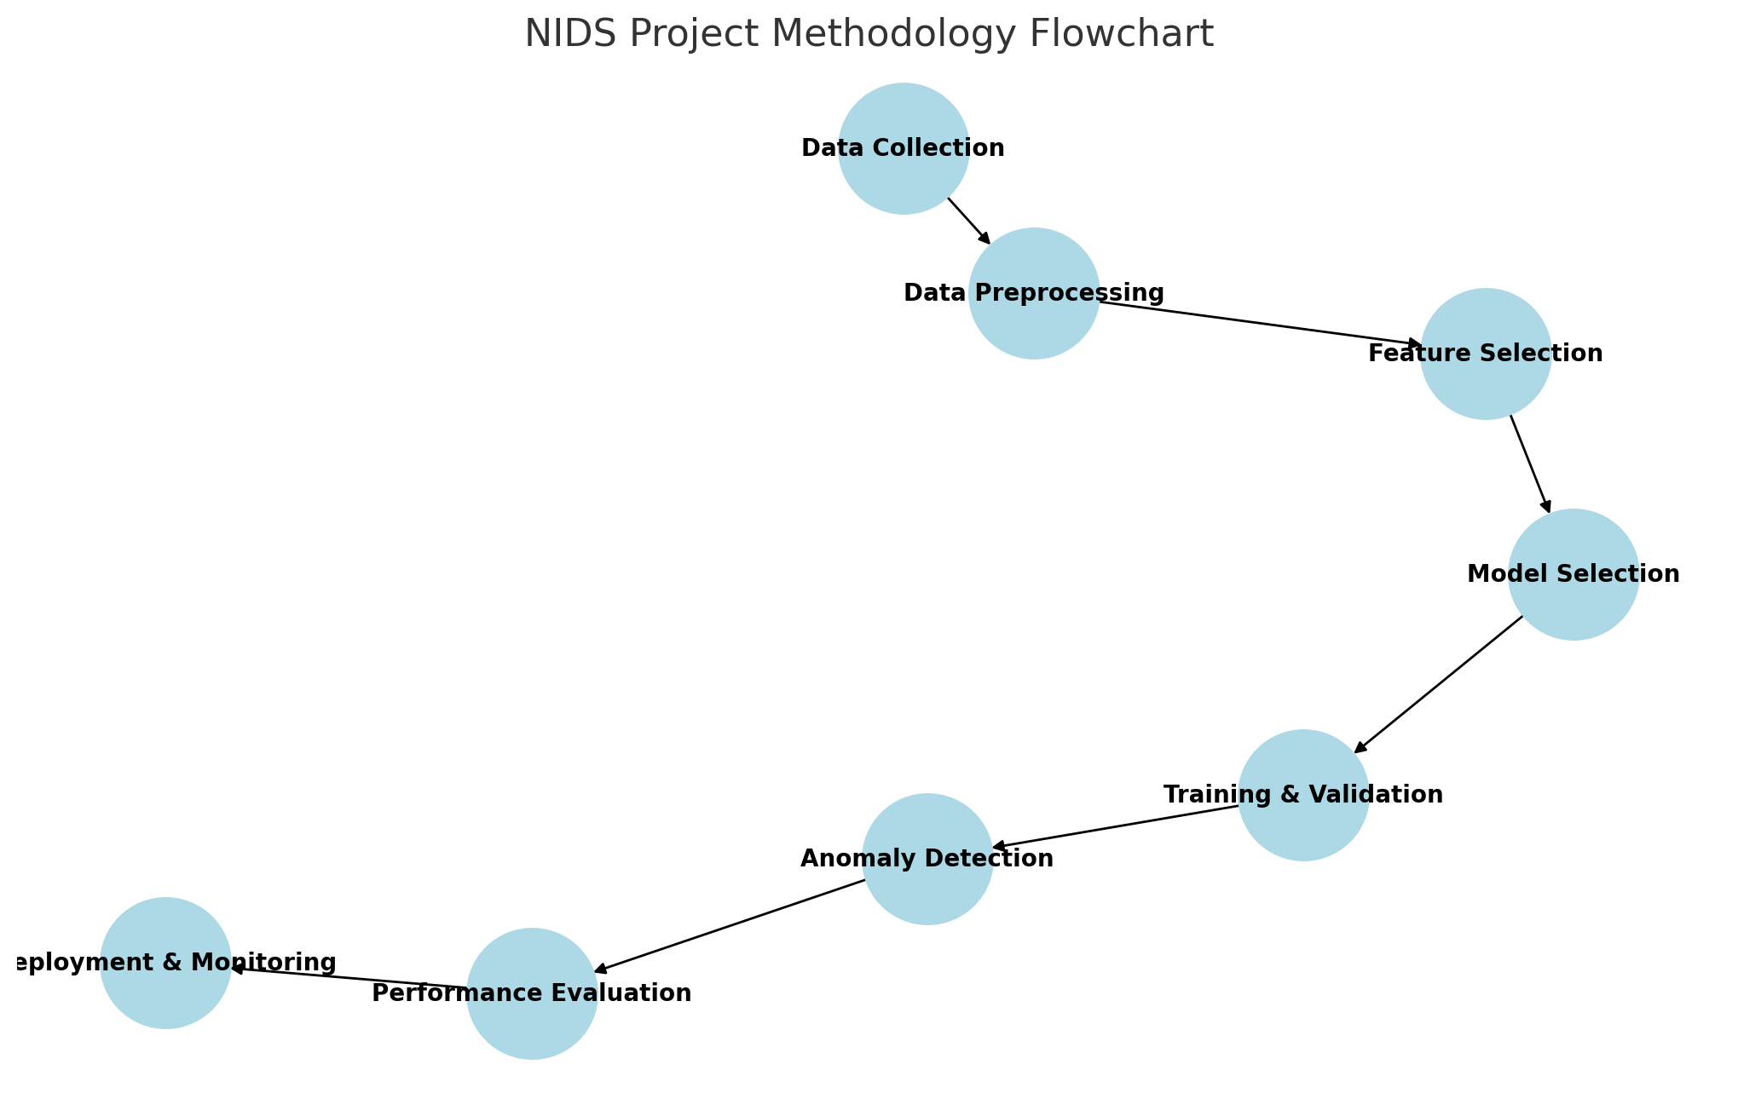
Methodology Flowchart
8
Notes:
New Courses replaced with New Programmes

Slide 9
Expected Results & Impact
High Detection Accuracy: The system will accurately detect known and unknown intrusions with minimal false positives/negatives, improving network security.​
​
Real-Time Detection: It will provide instant alerts for quick threat response, reducing potential damage from attacks.​
​
Reduced Human Intervention: Automated detection reduces reliance on manual monitoring, increasing operational efficiency.​
​
Adaptability to New Threats: The system will evolve with new attack patterns, ensuring long-term effectiveness.​
​
Cost Reduction: By automating detection, the system lowers operational costs and minimizes the risk of costly breaches.​
​
Scalability: The solution can handle growing network traffic, ensuring sustained performance as the organization expands.​
​
10
Notes:
New Courses replaced with New Programmes

Slide 10
THANK YOU
11

